Slide 1
Choosing Ideal Neighbourhood in Bangalore
DATA SCIENCE PROJECT BY AROHAN AJIT
April 2020

Slide 2
BUSINESS PROBLEM

Slide 3
OBJECTIVE
Business Problem:
Bangalore is one of the key destination for IT sector companies and experts. City has a huge population most of which are IT sector employees. It is also a preferred location for all the aspiring Software Engineers, Data Scientists and ML Engineers in India.
As such finding proper neighbourhood which satisfies all the needs of an individual can be a challenging task. This report aims to tackle this very problem
Interested Business:
This project can of use to Real Estate companies in Bangalore in order to find proper real estate in ideal locations for their customers
Target Audience
All the future would-be residents of Bangalore who are looking for proper locality to reside in

Slide 4
DATA

Slide 5
Location Data:
Location Data was scraped from Wikitable in Wikipedia using Beautiful Soup
Neighbourhood Location Data: 'https://en.wikipedia.org/wiki/List_of_wards_in_Bangalore‘
Location Coordinates Data:
Location data was taken from ARCGIS Geocoder API
Places of Interest Location Data:
Coordinates of all the POI were taken Foursquare developers API
FourSquare API
Map Data:
https://github.com/datameet/Municipal_Spatial_Data/blob/master/Bangalore/BBMP.GeoJSON

Slide 6
METHODOLOGY

Slide 7
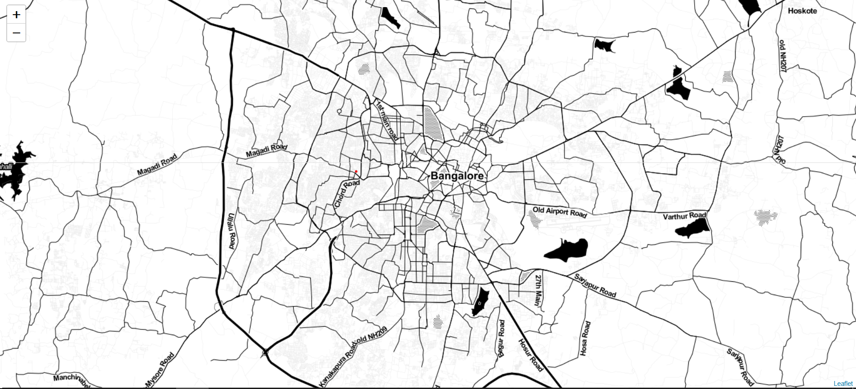
BANGALORE

Slide 8
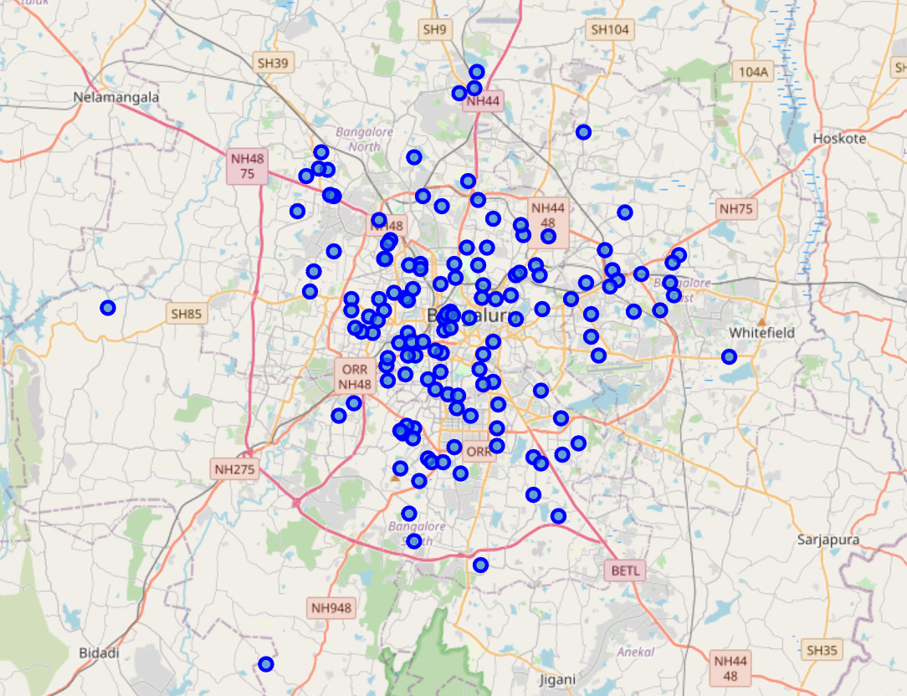
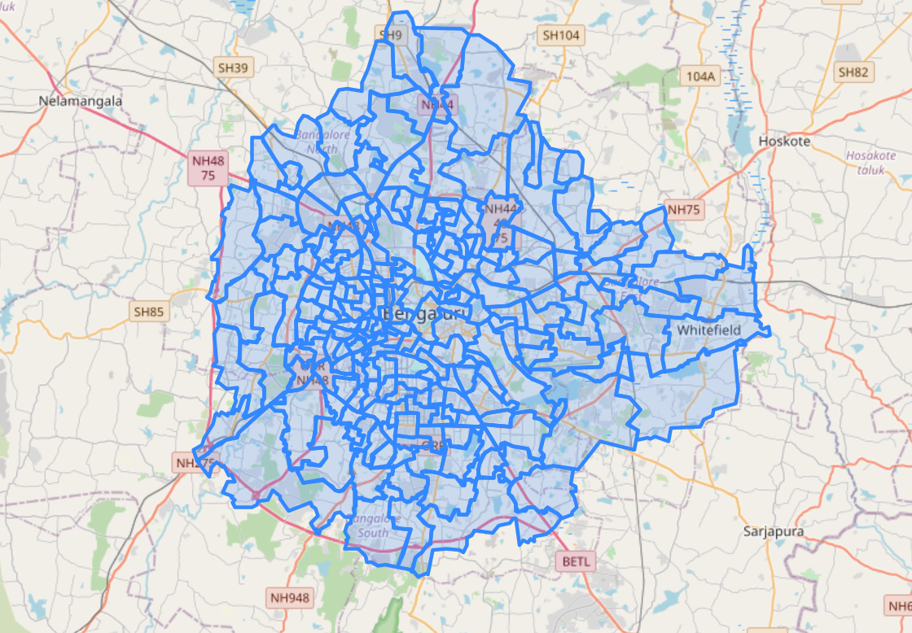
DISTRIBUTED AND HIGHLIGHTED DISTRICTS IN BANGALORE

Slide 9
LIST OF STEPS TAKEN FOR ANALYSIS
The data for different wards was scraped using Beautiful Soup library
Latitude and Longitude for each of the wards was taken using Geocoder API
Places of Interest in each ward were identified and their locations mapped using Foursquare API
Preferred features for an ideal neighbourhood were identified. This can vary person to person as everyone has different requirements.
Top 10 most common venues at each ward were identified and then they were clustered on basis of similarity
Priority of each ward was set on basis wards was that had maximum to offer from preferred features

Slide 10
RESULTS

Slide 11
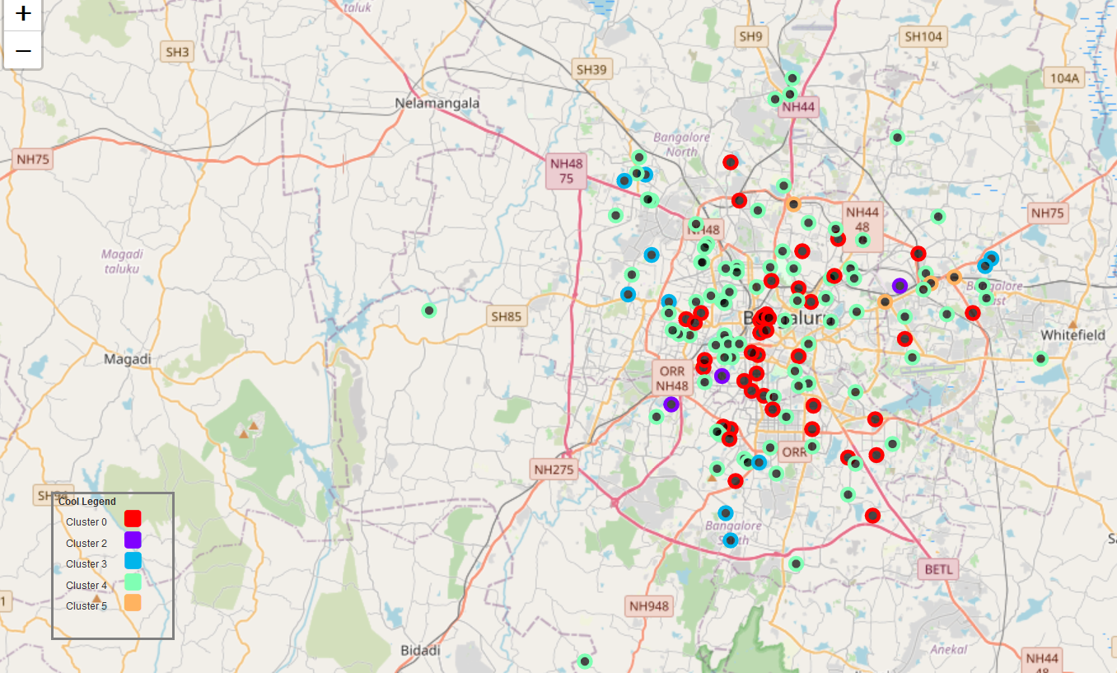
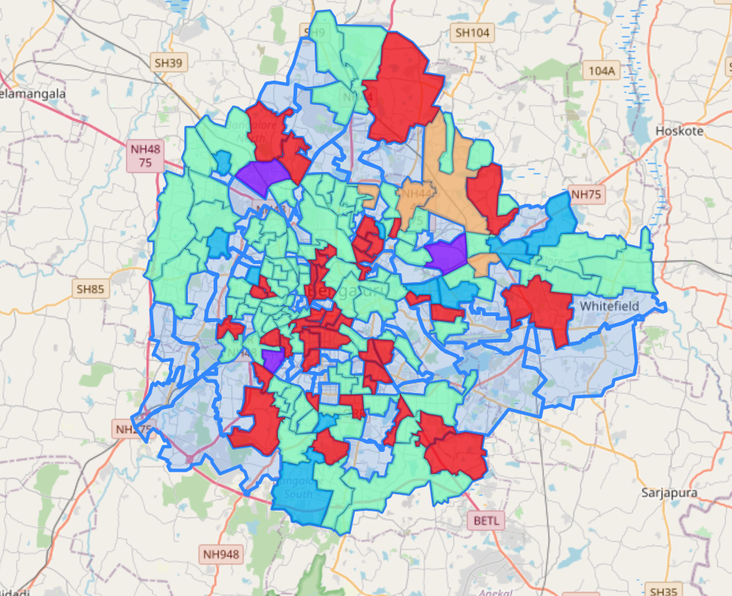
CLUSTERS IDENTIFIED

Slide 12

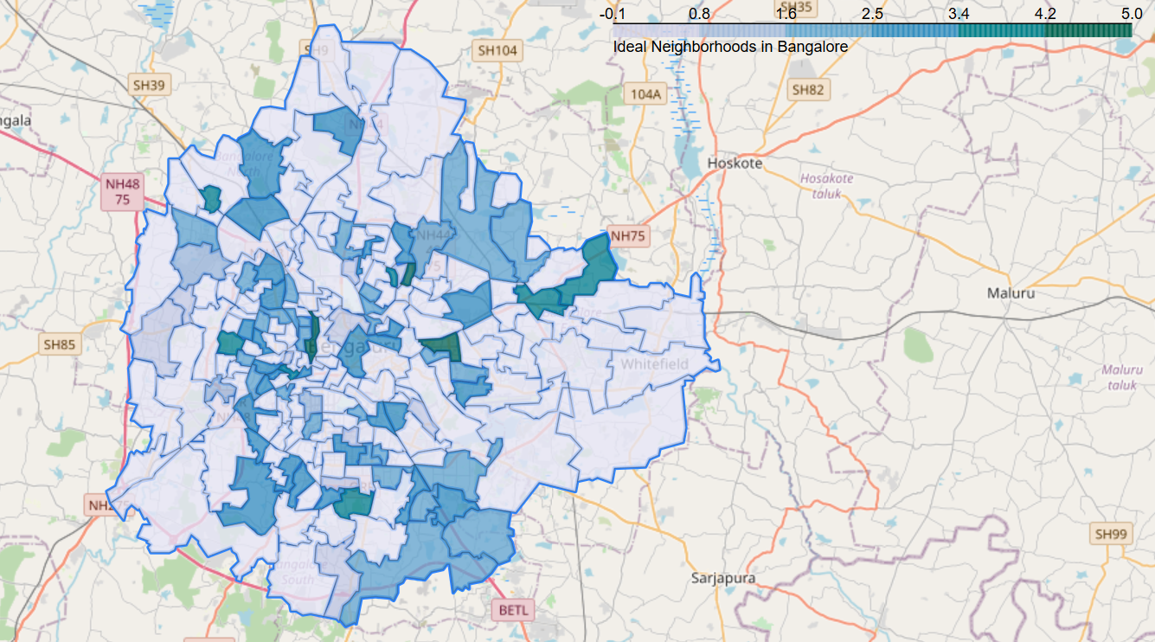
Preferred locations
IDENTIFIED CLUSTERS
PREFERRED WARDS

Slide 13
INFERENCE
From observing the above maps, it is clear that the area around Central Bangalore that is Cluster 1 is preferred the most followed by Cluster 4

Slide 14
DISCUSSION
It is quite pragmatic that locations around Central Bangalore are preferred for neighbourhoods. Being a planned city, most of the features preferred for ideal living conditions are situated there
Some of clusters like Cluster 4 are situated on the suburbs as well since there’s a sizeable population which prefers to live near their workplace which are normally situated on outer parts of the city
Some parts in Central Bangalore are not preferred for living as these are considered ‘Shopping Districts’ and mostly consists of Markets and Shops

Slide 15
RECOMMENDATION
It is recommended to take residence in Central Bangalore as it consists of most of the features preferable for comfortable living.
Some areas in suburbs are also suitable for residence – which while lacking in some features inside the city, provide less commute time to workplace

Slide 16
CONCLUSION
Suburbs can be further developed for better living conditions in order to increase wards with better housing facilities.
Developing more such areas can provide more affordable options for residence while easing the pressure on core locations in central
Better features can provided in up and coming locations in the city which are in process of becoming residential area

Slide 17
THANK YOU!

